Slide 1
Wireless propagation plan
UGent-Lille1-ASZ-SNCF
WISE advisory committee – 14 March 2013
Davy Gaillot (davy.gaillot@univ-lille1.fr)
Emmeric Tanghe (emmeric.tanghe@intec.ugent.be)

Slide 2
Motivation
Wireless in factories can be challenging
metallic environment
dynamic environment
Recent technologies bring about more challenges
e.g., MIMO, OFDM, and UWB
RSSI alone is no longer sufficient as a performance indicator
Therefore: wireless propagation research to learn about the nature of the industrial channel

Slide 3
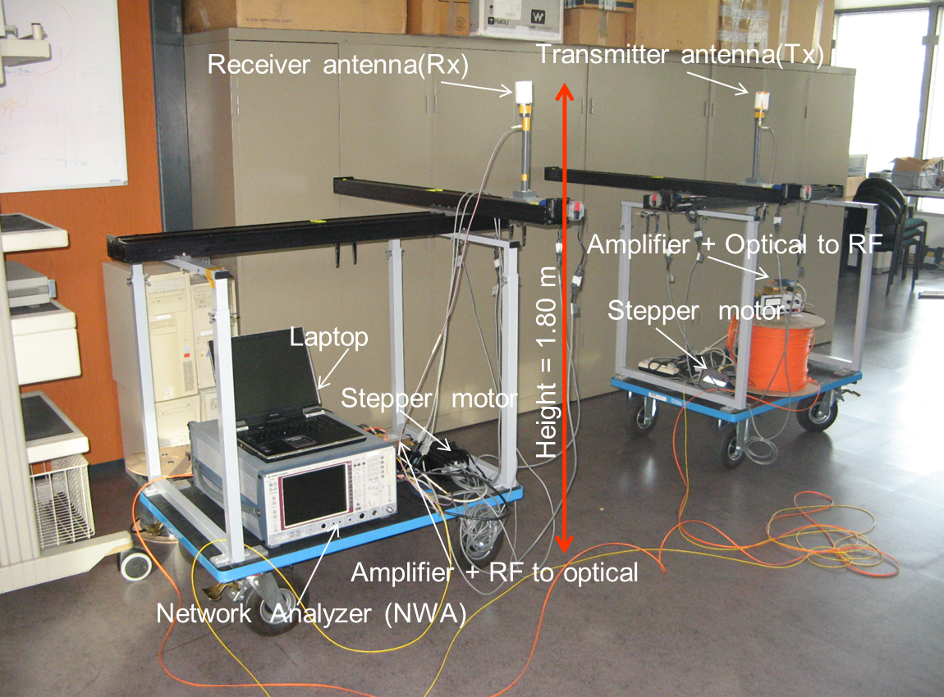
Measurement equipment
Wireless channel sounder
scans channel in space, frequency, and time
all these dimensions affect performance of modern wireless technologies (MIMO/OFDM/UWB)!

Slide 4
Conception système de mesures
Système peu invasif dans le milieu par rapport aux employés
Système autonome en énergie
Antenne de transmission/réception facilement déplaçable
Système de mesure semi-automatique
Mesure diversité polarisation

Slide 5
Solution
Réseau compact de type UCA – UCA
Antennes patch bipolaires
Antennes omnidirectionnelles à polarisation fixe
Utilisation de fibres optiques pour grandes distances entre Tx et Rx
Mesure de la fonction de transfert à l’aide d’un analyseur réseau vectoriel

Slide 6
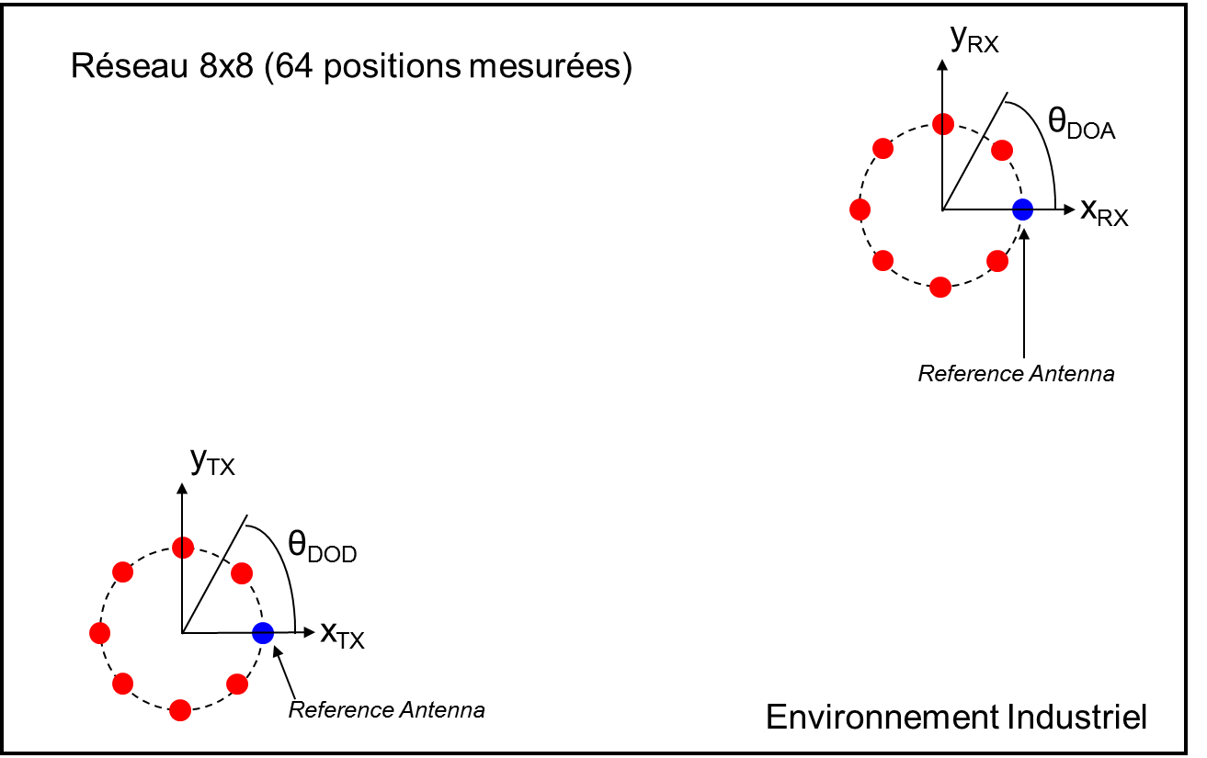
Design pour le réseau d’antennes

Slide 7
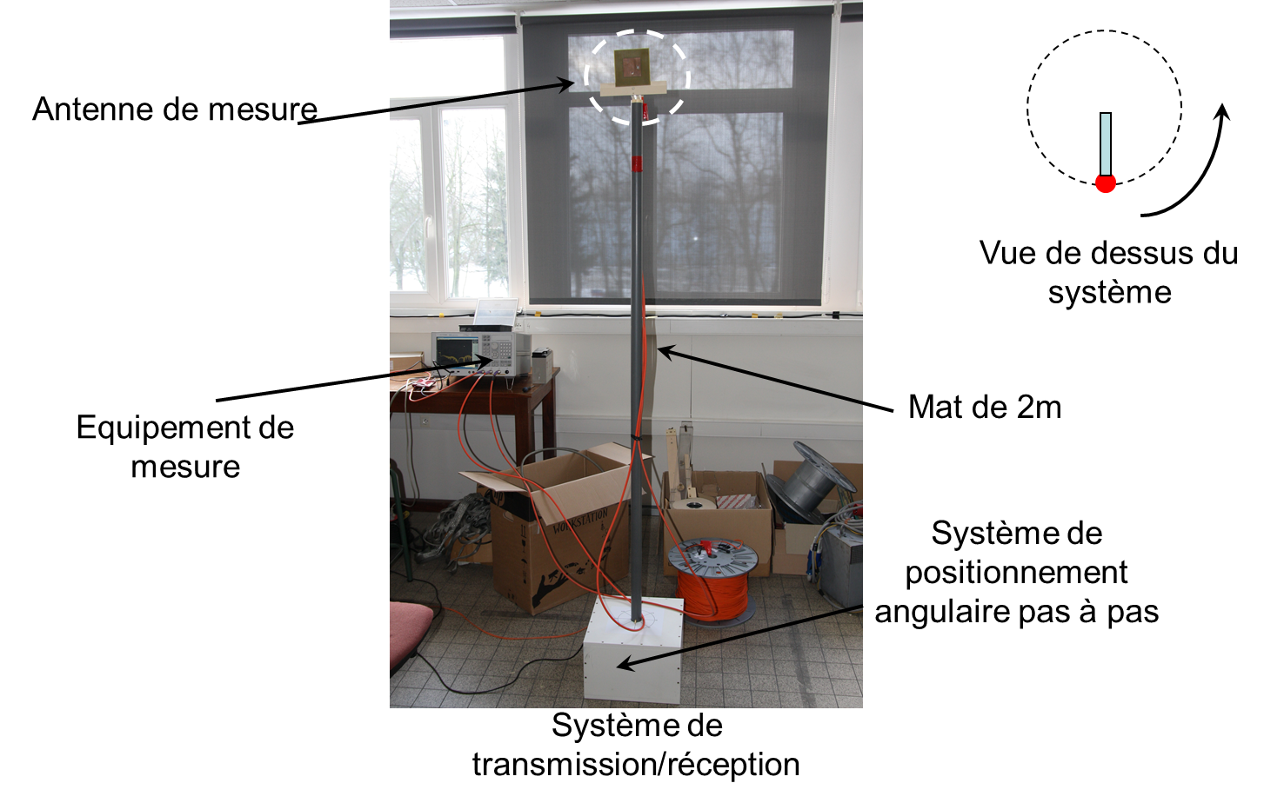
En photos

Slide 8
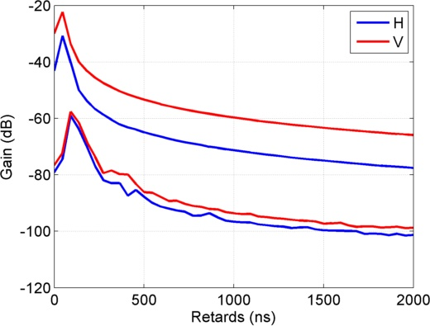
Résultats préliminaires
Mesures bipolaires 22 MHz bande 1.3 GHz

Slide 9
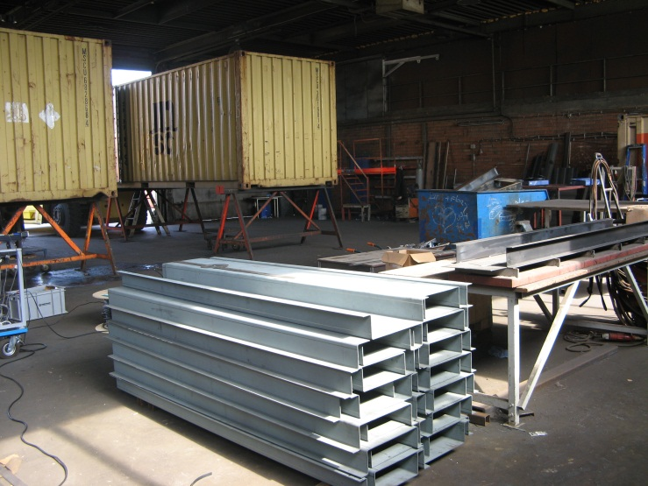
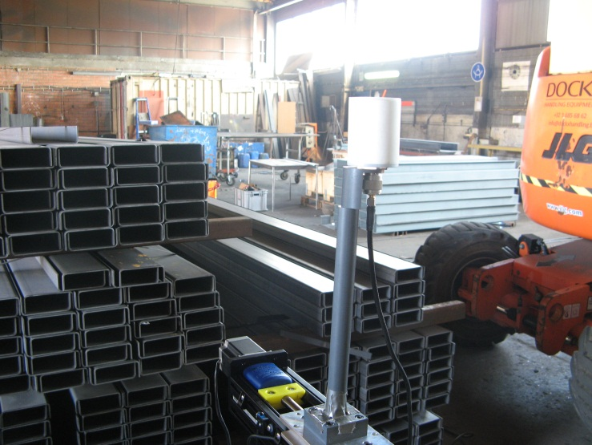
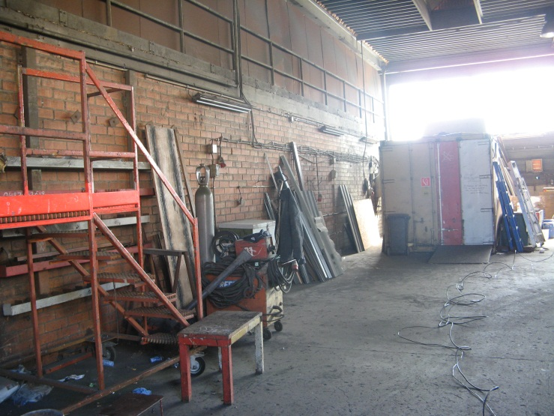
Measurement procedure
First test measurements in industrial environment
container repair shop in port of Antwerp

Slide 10
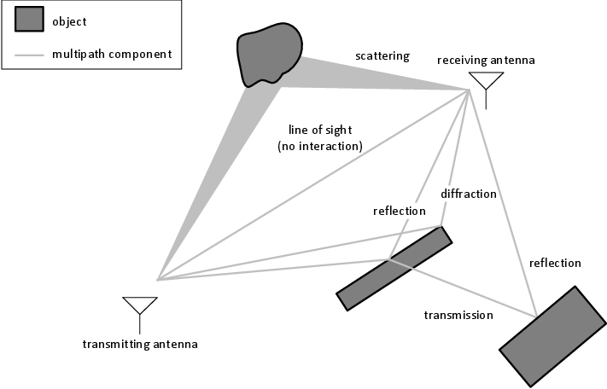
Measurement procedure
Extraction of physical channel parameters
Physical model of the channel = multipath
parameters:
time delay
angle of departure
angle of arrival
power

Slide 11
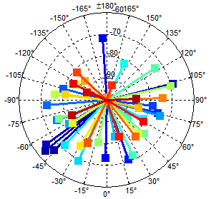
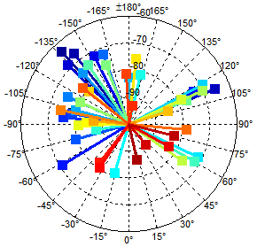
Measurement procedure
Parameter extraction
with maximum likelihood algorithms
example
angular at Tx
angular at Rx
Tx
Rx

Slide 12
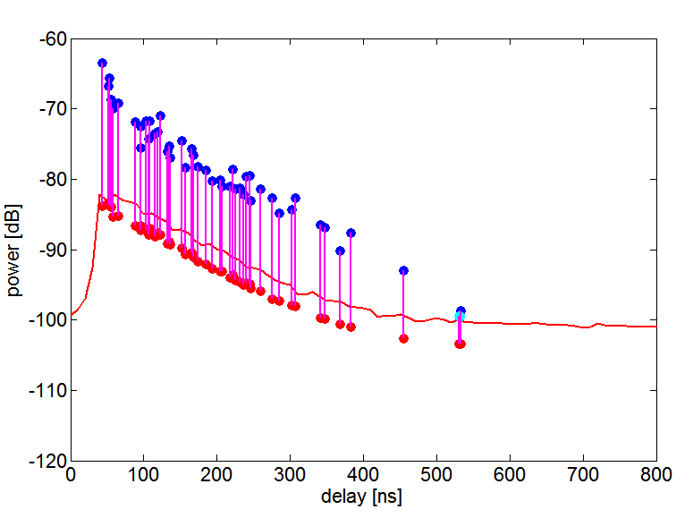
Measurement procedure
Parameter extraction
with maximum likelihood algorithms
example
time-delay at Rx
Tx
Rx

Slide 13
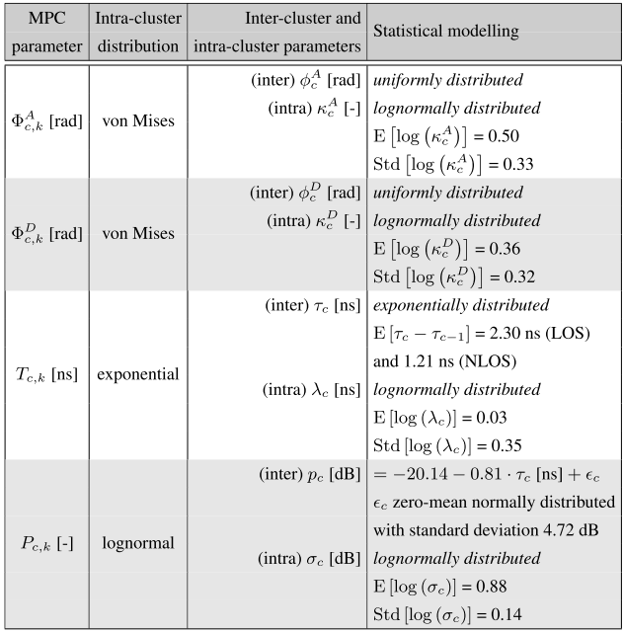
Measurement procedure
Industrial channel model
= statistics of physical channel parameters

Slide 14
Applications
Practical uses of channel models
link budget calculations (wireless range)
quantify MIMO benefits
diversity order (range increase)
multiplexing gain (bitrate increase)
simulation of RF exposure
comparison with measurements
channel playback/emulation in a testbed
e.g., for performance testing of a proprietary industrial MAC-protocol

Slide 15
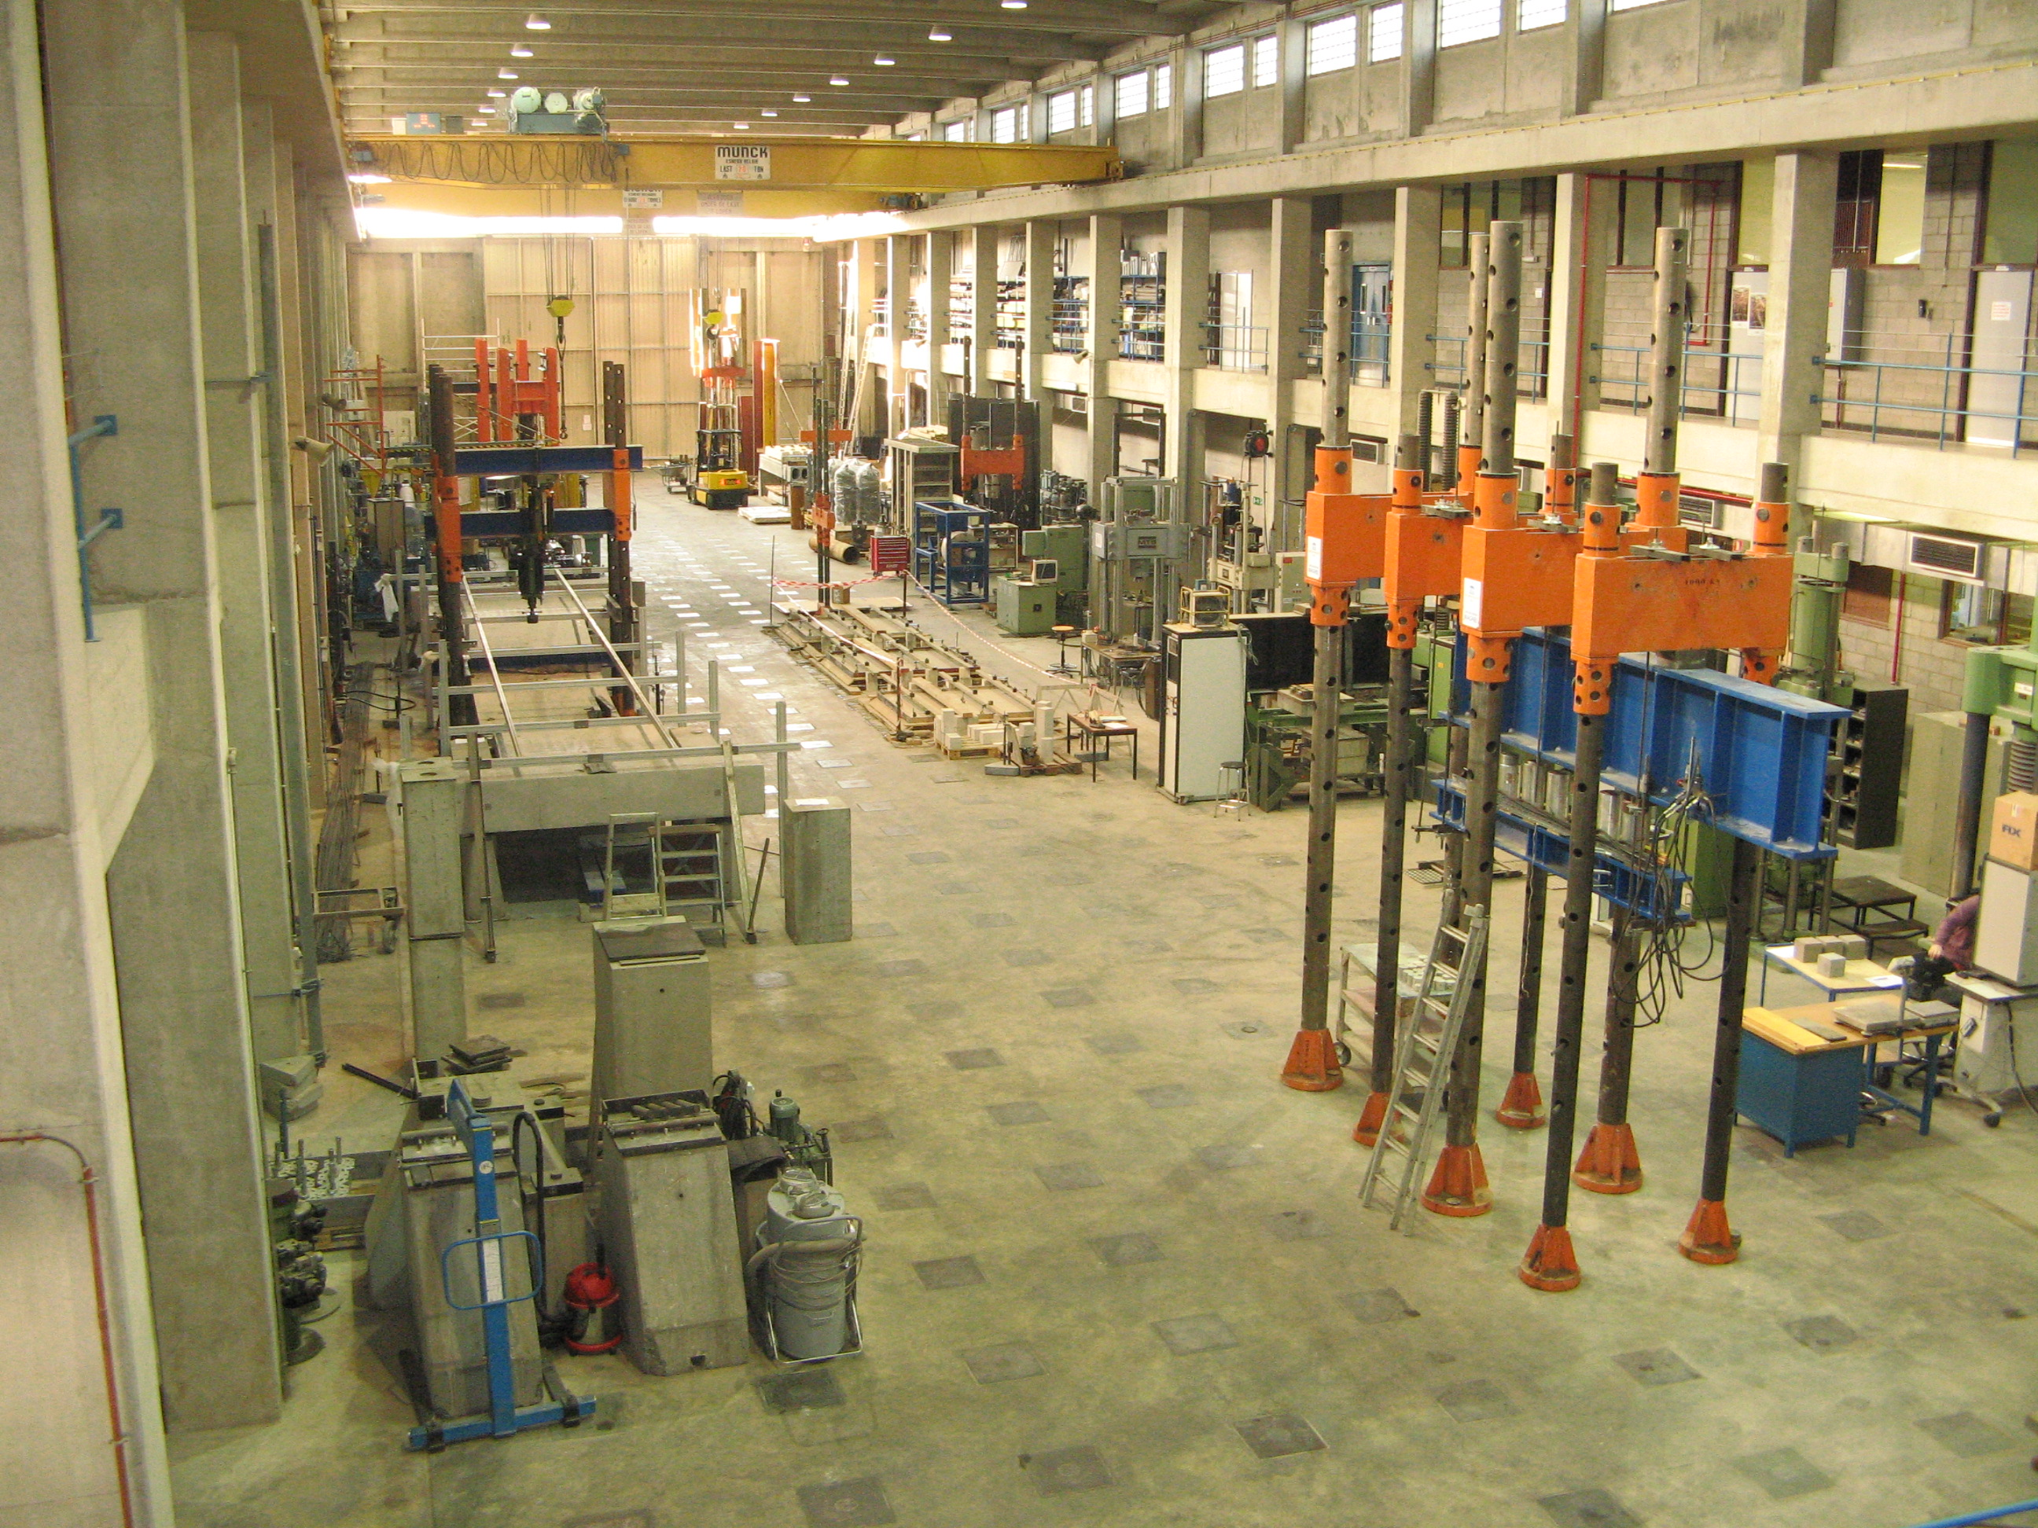
Planning and final goal
Measurement campaign
Labo Soete at Campus Zwijnaarde
SNCF in Lille
...
Goal: presentation of findings at final workshop

