Slide 1
EU directive for workers
Lille, March 14 2013
Wout Joseph
Wout.joseph@intec.ugent.be
Ghent University/iMinds
Department of Information Technology – Wireless & Cable

Slide 2
What is intention of norms for EM-fields?
Classification of norms
  Emission norms:
  limits for maximal leakage of radiation
  transmitted by equipment
  characteristic of equipment
  Exposure norms:
  maximum limits for intensity
  of electromagnetic radiation
  where persons under certain conditions
  are exposed
  characteristic for an environment

Slide 3
International organisations developing exposure guidelines
International
  ICNIRP International Commission on Non-Ionizing Radiation Protection (guidelines 1998, now changes for low frequencies 2010)
  WHO (World Health Association): follows ICNIRP guidelines with some minor deviations
  IARC: International Agency for Research on Cancer
    RF class 2B: possible carcinogenic since May 2011
European
  EU: recommendation of the Council of the member states of the EU (12-07-1999); Follows ICNIRP-recommendation
  (not European directive!)
  EU directive for workers

Slide 4
Definition basic restriction
Basic restriction
  Restrictions on exposure that are based directly on established health effects, physical quantity related to biological effect
    Current density J: f < 10 MHz (new: internal E-field)
    Current I: f < 110 MHz
    SAR: 100 kHz < f < 10 GHz
    SA (Specific energy 300 MHz < f < 10 GHz (pulsed fields)
    Absorption = SAR x time)
    Power density S: 10 GHz < f < 300 GHz
  Difficult to measure in living beings
Notes:
Waarom zijn basisrestricties moeilijk te controleren? Men kan bijvoorbeeld geen probe in de mens implanteren om de SAR te meten. Daarenboven is SAR plaatsafhankelijk zodat men oneindig veel probes in het lichaam zou moeten inbrengen.

Slide 5
Definition reference level
Reference levels
  Physical quantity characterizing exposure in the human body: electric or magnetic field, power density
  Easier to measure than SAR
  Measured value < reference level
  basic restrictions satisfied
  Measured value > reference level
  Not necessarily that basic restriction is exceeded: e.g., mobile phone (< 2 W/kg), anti-theft gate,….

Slide 6
ICNIRP norms (1998, 2010)
Used in most EU countries

Slide 7
Summary scientific basis for basic restrictions
1 Hz < f < 10 MHz
  Limits for current density (internal electric field since 2010) prevent effects on the central nervous system (CNS)
100 kHz < f < 10 GHz
  Limits for SAR prevent whole-body heat stress and excessive localized tissue heating: thermal effects
10 GHz < f < 300 GHz
  Limits for power density prevent excessive heating in skin tissues and tissues close to the body surface

Slide 8
Difference general public – occupational exposure in norms
Occupational exposure: adults that are
  exposed occupationally
  generally exposed under known conditions
    Healthy and not specially sensitive to EM fields
  and are trained to be aware of potential risk and to take appropriate precautions
General public: individuals of all ages that
  Have verying health conditions
  Can be sensitive to EM fields
  Are exposured to circumstances that are unknown by the indivdual
  Do not take appropriate precautions
Selected safety factors
  10 for occupational exposure
  50 for general public
NOT EU definition of workers….
Notes:
Reason
Uncertainty about relation between physical quantities (e.g., current density -SAR) and adverse health effects due to limited accuracy of dosimetry
Even if limit values are exceeded no concern is required
Additional factors taken into account
Effect of exposure to EM–fields in extreme conditions (e.g., high temperatures) and high activity levels
Potentially higher thermal sensitivity of children and ill people

Slide 9
Basic restrictions for EM fields up to 10 GHz
ICNIRP 1998
Exposure
Characteristics
Occupational
exposure
Exposure
Of the general
public
Frequency range
up to 1 Hz
1 - 4 Hz
4 Hz - 1 kHz
1 - 100 kHz
100 kHz - 10 MHz
10 MHz - 10 GHz
up to 1 Hz
1 - 4 Hz
4 Hz - 1 kHz
1 - 100 kHz
100 kHz - 10 MHz
10 MHz - 10 GHz
Current density for
head and trunk
(mA m⁻²) (rms)
40
40/f
10
f/100
f/100
-
8
8/f
2
f/500
f/500
-
Whole-body
Average SAR
SAR (W kg⁻¹)
-
-
-
-
0.4
0.4
-
-
-
-
0.08
0.08
Localized SAR
(head and trunk)
(W kg⁻¹)
-
-
-
-
10
10
-
-
-
-
2
2
Localized SAR
(limbs)
(W kg⁻¹)
-
-
-
-
20
20
-
-
-
-
4
4

Slide 10
European directive for workers
DIRECTIVE OF THE EUROPEAN PARLIAMENT
AND OF THE COUNCIL
on the minimum health and safety requirements regarding the exposure of workers to the risks arising from physical agents (electromagnetic fields)
(XXth individual Directive within the meaning of Article 16(1) of Directive 89/391/EEC)

Slide 11
European directive for workers
In 1989, the European Commission developed a directive to protect workers against “physical agents” : Framework directive 1989/391/EEC
4 Directives were developed
  Vibrations (2002/44/EC)
  Sound pollution (2003/10/EC)
  Electromagnetic fields (EMF) (2004/40/EC)
  Optical radiation (2006/25/EC)

Slide 12
Framework directive 1989/391/EEC
Applicable on all 4 directives
Basis principles: obligations for employers
  Determination of exposure and assessment of risk
  Measures to prevent or reduce risks
    Ensure that exposure limits are never exceeded
  Information and teaching for employees
  Health inspection

Slide 13
EMF directive (1)
Goal: protection of workers with respect to acute effects of electromagnetic exposure
Defines exposure limits for EMF for frequencies up to 300 GHz
  Limits almost identical to ICNIRP guidelines
  which are based on acute effects (CNS stimulation, temperature effects, etc.)
  ICNIRP 1998 and 2010
Explicite statement: long-term effects (cancer induction) are excluded from the objective of the directive

Slide 14
EMF directive (2)
EMF directive started at 30 April 2004. First member states could implement directive until 30 April 2008
New 2008/46/EC has postponed implementation to 30 April 2012
Again postponed to 2013 (now final 2013)
  Countries have 3 years to implement legislation: 2016
  Based on ICNIRP 1998 and 2010 for workers
  List of sources where no measures are needed
  Directive 89/391/EEC
  Probably final version in April 2013
    Adopted before October 31, 2013
    Transposition in Belgian law before October 31 2016
Notes:
Directieve informatie: http://europa.eu/legislation_summaries/employment_and_social_policy/health_hygiene_safety_at_work/c11150_en.htm
Different opinions: Europese Raad vs. Europees Parlement

Slide 15
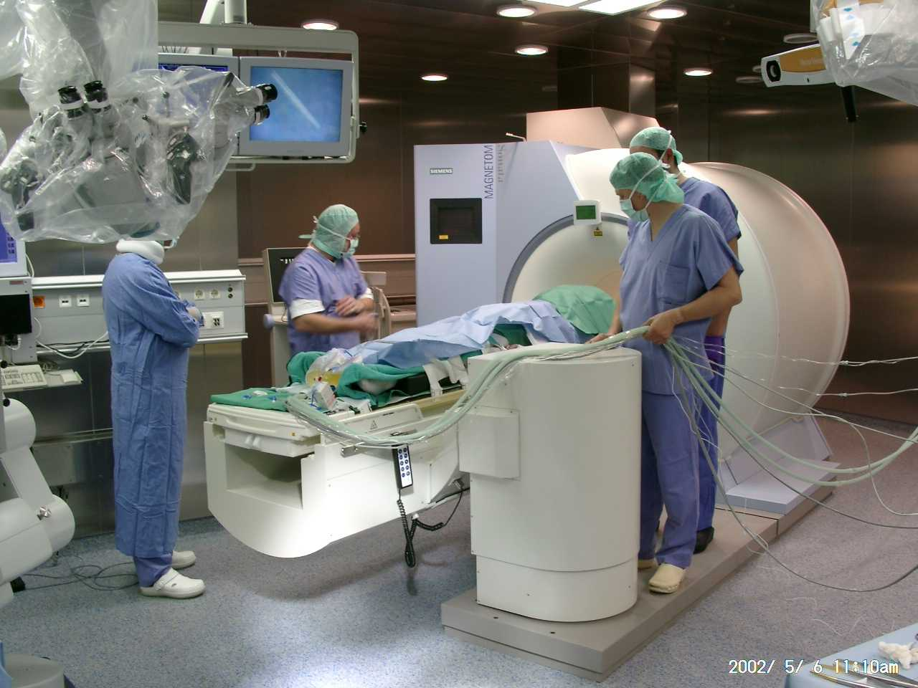
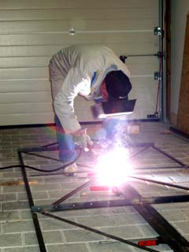
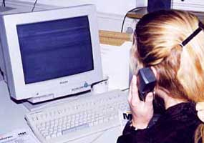
Working place?
Directive is applicable on all working places, no special exclusions for medical environments
Not only occupational exposure as in ICNIRP

Slide 16
Why delay of implementation date?
Protest of MRI (Magnetic Resonance Imaging) industry because MRI would be impossible
Protest of Armed Forces (NATO)
Terminology
  Exposure limit values (ELV): ICNIRP occupational basic restrictions
    May never be exceeded
  Action values (AV): Based on ICNIRP occupational reference values
    Below AV then definitely below ELV
    Above AV means possibly above ELV
→ Employer must take action

Slide 17
Content of the new Directive (preview)
Subject-matter and scope
Definitions
Exposure Limit Values and Action Levels
Assessment of risks and determination of exposure
Provisions aimed at avoiding or reducing risks
Worker information and training
Consultation and participation of workers
Health surveillance
Penalties
Derogations
Miscellaneous (practical guide; transposition 3 years after the day of entry)
Annexes I : physical quantities
Annex II : ELV en AL Non-thermal effects 0 Hz - 10 MHz
Annex III: ELV and AL Thermal effects 100kHz - 300 GHz

Slide 18


Measures
Which?
Determination of risk zone
Instructions for employees
Placement of a warning sign
Fences
Replacement of source
Changement of working place of worker
Reinstallation of system

Slide 19
Health effects ELV
100 kHz to 6 GHz and 6 GHz to 300 GHz
Health effects ELV | SAR values averaged over any 6 minutes
ELV related to whole body heat stress expressed as averaged SAR in the body | 0.4 W/kg
ELV related to […]localised heat stress in head and trunk expressed as localised SAR in the body | 10 W/kg
ELV related to […]localised heat stress in the limbs expressed as localised SAR in the limbs | 20 W/kg.
Frequency range | Health effects ELV related to excessive heating at the body surface
6 GHz ≤ f ≤ 300 GHz | 50 W/m²

Slide 20
Sensory effects limit ELV from 0,3 GHz to 6 GHz avoiding auditory effects caused by pulsed micowave exposure of the head
Frequency range | Localised Specific Absorption (SA)
0.3 ≤ f ≤ 6 GHz | 10 mJ/kg.

Slide 21
Action levels for exposure to electric and magnetic fields
100 kHz to 300 GHz
Frequency range | Electric field strength AL(E) [V/m] (RMS) | Magnetic flux density AL(B) [μT] (RMS) | Power density AL(S) [W/m²]
100 kHz ≤ f < 1 MHz | 6.1 x 10² | 2.0 x 10⁶ /f | -
1 ≤ f < 10 MHz | 6.1 x 10⁸ /f | 2.0 x 10⁶ /f | -
10 ≤ f < 400 MHz | 61 | 0.2 | -
400 MHz ≤ f < 2 GHz | 3 x 10^{-3 f ½} | 1.0 x10⁻⁵ f^{1/2} | -
2 ≤ f < 6 GHz | 1.4 x 10² | 4.5 x10⁻¹ | -
6 ≤ f≤ 300 GHz | - | - | 50

Slide 22

Questions?

