Slide 1
Exposure assessment / installations
Lille, March 14, 2013
UGent-Lille1-ASZ-SNCF
Leen Verloock
Leen.Verloock@intec.ugent.be
Ghent University/iMinds
Department of Information Technology – Wireless & Cable

Slide 2
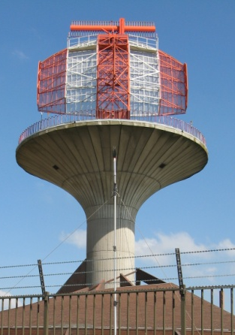
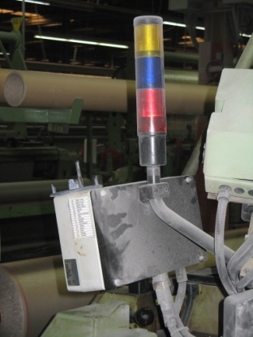
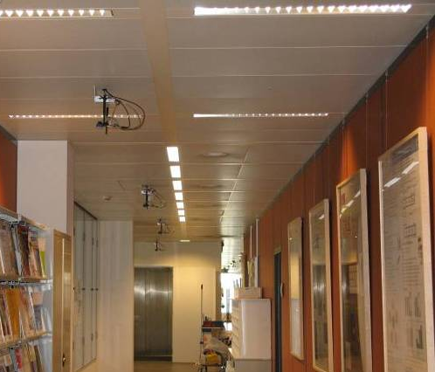
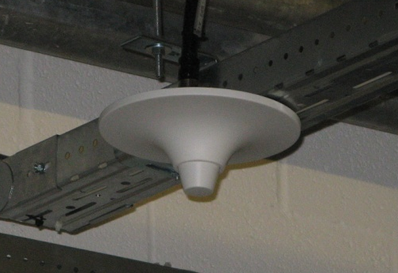
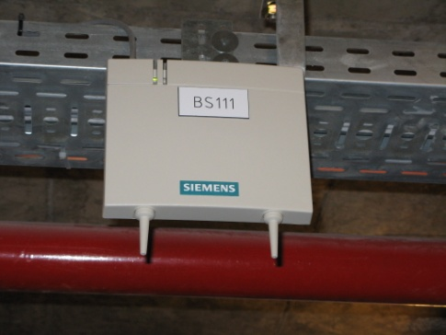
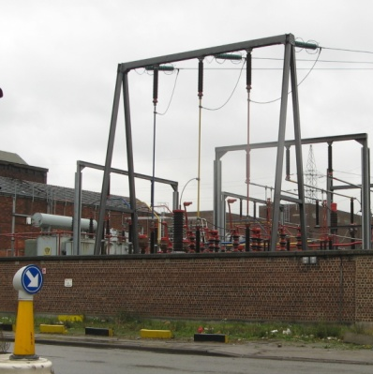
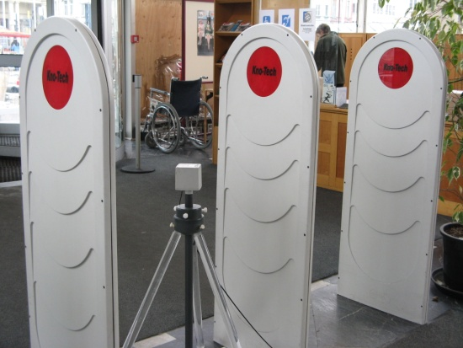
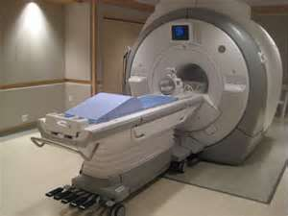

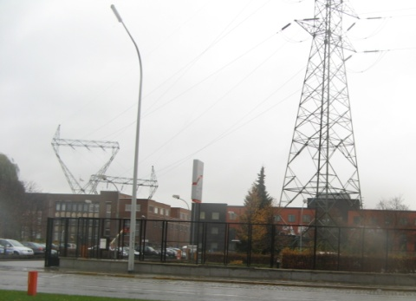
Electromagnetic sources
Electric equipment generates electromagnetic waves
  Equipment for wireless communication
  BUT also other sources generate RF radiation

Slide 3
Classification
Classification of RF sources is required to do a risk analysis
  Assessment of risk
  Define safety rules (e.g. safety distances / desactivation during maintenance)
  Advise employees
  Satisfy EU directive

Slide 4
Classification based on risk
Working environments can be divided into 3 categories (based on a study of Bolte and Pruppers)
  Category 1
    Under normal conditions the action values will not be exceeded
  Category 2
    Action values can be exceeded but the exposure limit values will not be exceeded under normal conditions
  Category 3
    Exposure limit values can be exceeded
Category 3
Exposure limit value
Category 2
Action value
Category 1

Slide 5
Classification

Slide 6
Classification based on application
Classify equipment in the right category
  1) Inventory of all equipment
  2) Exposure assessment around each source
  3) Risk analysis for each source
  4) FINAL GOAL: DATABASE + SOFTWARE tool to assess the exposure / risks around each kind of source

Slide 7
Classification based on application
Inventory of all equipment
  Document ‘Electromagnetic sources’ is available
  Classify equipment in different sectors and subdivide into different categories
    Industrial sector (electrochemical processes, electric welding, ...)
    Electricity sector (electricity production, distribution, ..)
    Broadcasting sector (radio and television)
    Telecommunications sector (base stations, WiFi, ...)
    Radar
    Aviation (surveillance, ...)
    Medical sector (MRI,...)
    Trade and services (metal detectors, ...)
    Public transportation (Transformers in trains, ...)
    Offices (computer screens, ...)
    Miscellaneous (electronic ballasts of fluorescent lamps, ...)

Slide 8
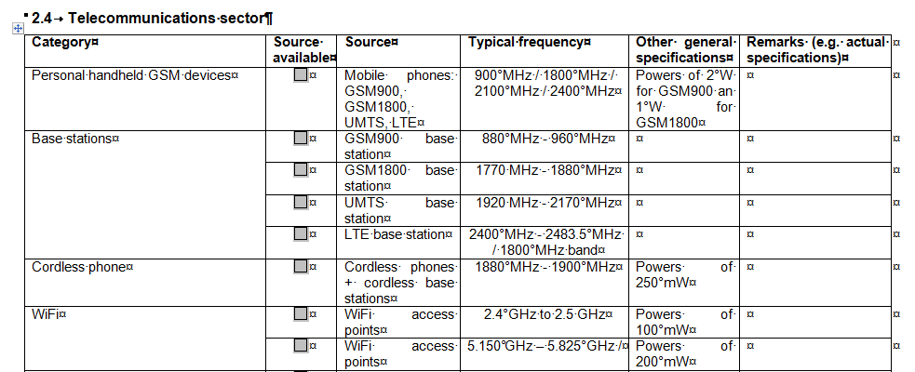
Classification based on application
TO DO
  Complete the checklist ‘Electromagnetic sources’ (already sent by email)
  Add the specifications of each available source
    Input Power
    Frequency
    Kind of signal (continuous / pulsed)
    Provide all technical documents of the present sources

Slide 9
Exposure

Slide 10
Exposure: general
Exposure around electric equipment
  Measurement projects + Literature
    Measurement projects e.g. Belgocontrol, Infrabel, BIM, FOD, LNE, ...
    International papers and studies
Additional measurements
  New sources
  Sources for which less information is available
  Specific equipment

Slide 11
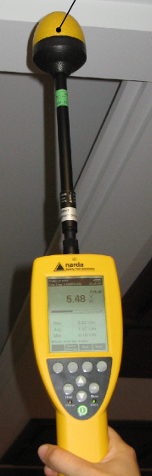
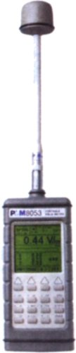
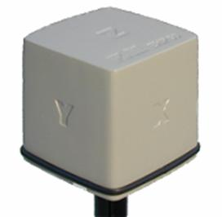
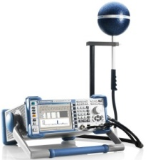
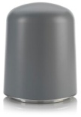

Exposure measurements
Two types of measurements
  Broadband measurements
    Frequency range: 100 kHz – 40 GHz
  Smallband measurements
    Frequency range: 5 Hz – 26.5 GHz
    Using different measurement devices:
      EHP-50C: 5 Hz – 100 kHz
      EHP-200: 9 kHz – 30 MHz
      Spectrum analyzer + TS-EMF probe: 30 MHz – 3 GHz
      Spectrum analyzer + R&S probe: 2 GHz – 6 GHz
      Spectrum analyzer + HF907OM: 800 MHz – 26.5 GHz

Slide 12
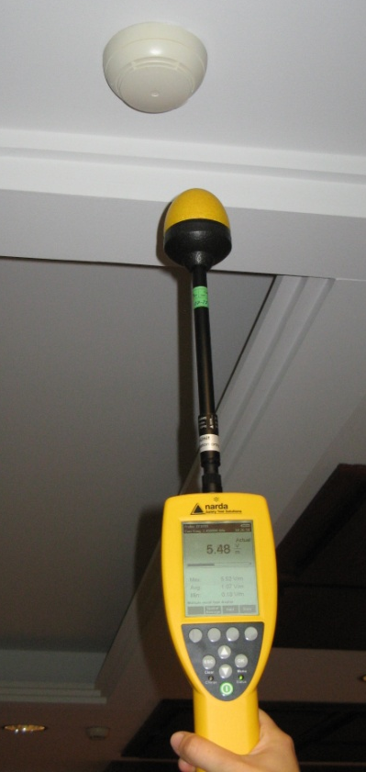
Measurements
Broadband measurements
  1 single value for broad frequency range
  Pro
    Fast, mobile
    No post-processing
    User friendly
    First idea of present field value
  Contra
    Low sensitivity
    No identification of the sources
    (no information: frequency <> field value)
    1 Measurement procedure independent of the technology

Slide 13
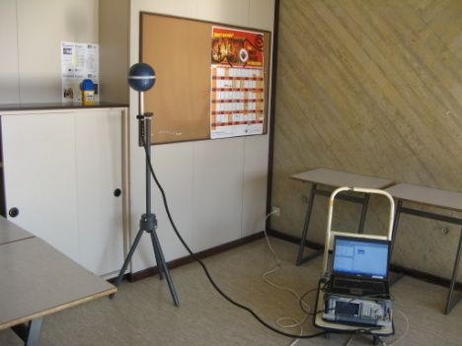
Measurements
Smallband measurements
  1 value for each existing signal
  PRO
    Settings are adjustable => measurement procedure depends on the technology
    Identification of the source
    Field contribution per source
  Contra
    Time consuming
    (measurement of 1 signal takes about 5 minutes)
    Complex – no handheld device
    No direct result - Post processing needed

Slide 14
Conclusions
Identification of sources
Plan for further field measurements
Any remarks are welcome

